Slide 1
TALKING WITH PATIENTS
Mustafa Al-Badran
F.I.B.M.S C.A.B.I.M
M.B.Ch.B

Slide 2
Good communication is essential in good patient care; it supports the building of trust between doctor & the patient

Slide 3
How will you sit?
Arrange the seating in a non-confrontational way.
If you use a desk, arrange the seats at the corner of the desk. This is less formal and helps communication (Fig. A, B).

Slide 4
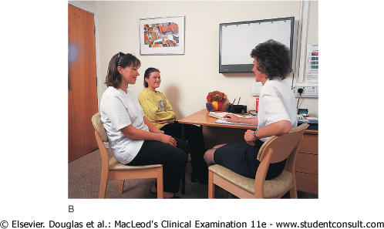

Slide 5
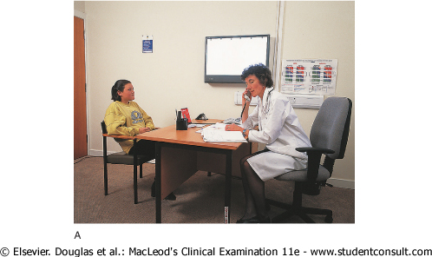

Slide 6
How will you sit?
If you use a computer make sure the screen and keyboard do not get in the way or provide a distraction. Turn away from the screen to talk to your patient.
If you are in a ward, pull up a chair and sit level with your patient (Fig. C). It is important that you can see your patient easily and gain eye contact

Slide 7
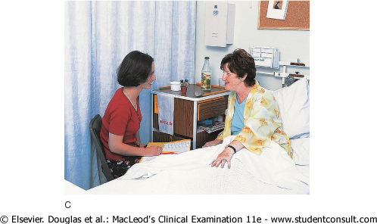

Slide 9
Non-verbal communication
First impressions are important. Your demeanor, attitude and dress influence your patient from the outset.
At all times you need to be professional in dress and behaviour.
This does not mean you need to be formal, but you must be neat, clean and polite.

Slide 10
Non-verbal communication

Slide 13
Non-verbal communication
Pick up non-verbal clue from your patients.
Are they distressed?
What is their mood like and how do their demeanor and body language change during the consultation? This gives clues to difficulties they are having that they cannot express verbally.

Slide 18
If people are getting uncomfortable during a line of questioning their body language may become 'closed', i.e. they may cross their arms and legs and fail to keep eye contact.

Slide 20
Before starting, make sure you are talking to the correct patient. Introduce yourself, as your patients should know who you are and what you do.

Slide 21
Example
Good morning Mrs Jones, I have got the right person haven't I? I am Mr Brown. I am a fourth year medical student. I've been asked if I could come and talk to you and examine you as you have just come into the ward today. Is that OK?
It might take me 20-30 minutes if that is alright with you.
I would like you to tell me what has been happening and then I'll want to ask a few questions and examine you.

Slide 22
Patient's name
After introducing yourself and confirming your patient's name
Insist on Full name including the Family Name
Fatal errors my Occur when two patients with the same name have been under treatment in the hospital simultaneously
This gives sense of familiarity

Slide 23
continue by asking for details of their background including

Slide 24
Sex
Diseases which are common in females as
SLE
Sjögren syndrome
Thyroid disease
Diseases which are Common in males as
Haemophilia

Slide 25
Age & Date of birth
Diseases common in children and young adults e.g.
Acute rheumatic fever
Viral Hepatitis A
Tumours common in children and young adults e.g.
Wilm’s Tumour of the kidney
Acute Leukaemia
Diseases common in Elderly e.g.
Atherosclerosis and IHD
COPD
Multiple Myeloma

Slide 26
Marital status
Single, Married, Divorced, Separated and Widow
Duration of marriage
Number of children
The age of youngest child

Slide 27
Current occupation
Certain occupations may expose the patient to certain diseases
Aniline dye.........Urinary bladder cancer
Sewer ……..Leptospirosis
Glass workers……Silicosis

Slide 28
Nationality
East Mediterranean(Turkey) … Behcet’s disease
China & Japan….C.A Stomach
Iran…C.A Oesophagus
Egypt…Schistosoma Mansoni

Slide 29
Religion
Ashkenazi Jewish …Crohn’s disease

Slide 30
Address
Full address including the phone number
Benefits e.g.
North of Basrah villages … Cancer risk increase
South of Basrah villages … Sickle cell anaemia

Slide 31
Next of kin
The closest person to the patient that took care of him and responsible for decision making if the patient can not make it e.g. when the patient become unconscious and need immediate intervention

Slide 32
Source of referral
From
Private clinic ….elective case
Primary heath care centre … elective case
Emergency department … emergency case

Slide 33
Date of admission
The time that the patient spent in the hospital my give clue about the severity of the disease and the effectiveness of hospital measures

Slide 34
Presenting Complaint
The complaint which made the patient come to the doctor in private clinic, primary health care or hospital …etc. .

Slide 35
Start with open questions but then gradually focus down on symptoms by using closed questions.
Choose your words carefully since patients may misinterpret questions such as 'What are you complaining of?' as implying that you regard them as complainers.

Slide 36
Try
What would you say your main problem is?'
Tell me why you have come to hospital
Follow up with 'What has happened to you since then’

Slide 37
The end

